Slide 1


Evaluating Competing Uses
for Marine Renewable Energy
Ben Best¹, Levi Kilcher², Walter Musial²
Pacific Region Marine Renewables Environmental Regulatory Workshop Portland, OR September 12, 2017
¹ EcoQuants, Santa Barbara, CA
² National Renewable Energy Lab, Golden, CO

Slide 2
Need for marine renewable energy
Reduce:
Greenhouse gases
Foreign dependence on energy
Marine energy advantages:
Complementary to other large scale renewable energy
Predictable throughout day and seasons
Proximity to dense coastal populations
Notes:
(NIMBy)

Slide 3
Outline
Challenges
Past Approaches
Present Cable Analysis
Future Competing Use Analysis

Slide 4
Challenges

Slide 5
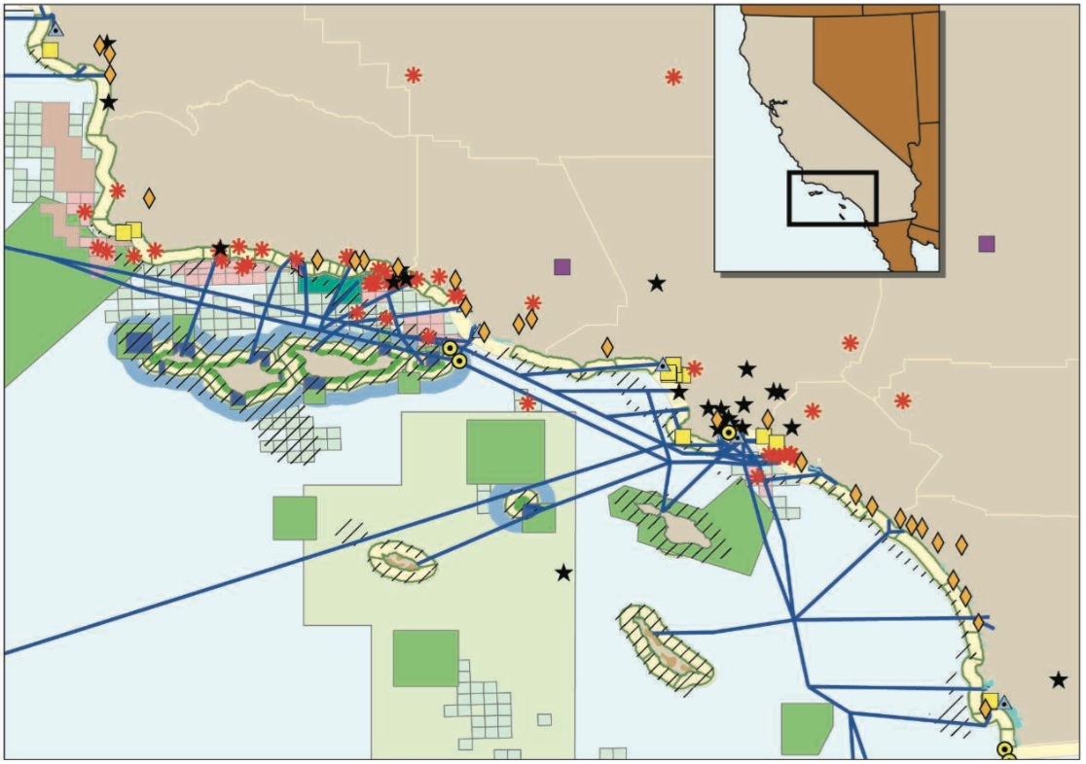
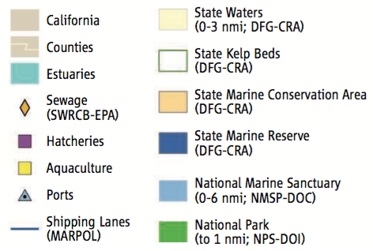
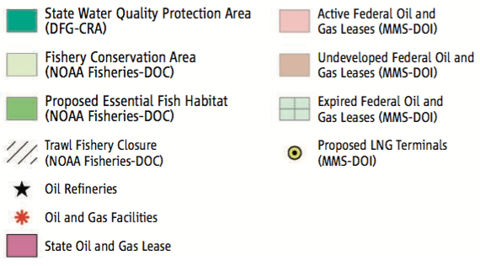
Crowded ocean
Crowder et al (2006) Resolving Mismatches in U.S. Ocean Governance. Science
Notes:
Can’t do MSP unless have data

Slide 6
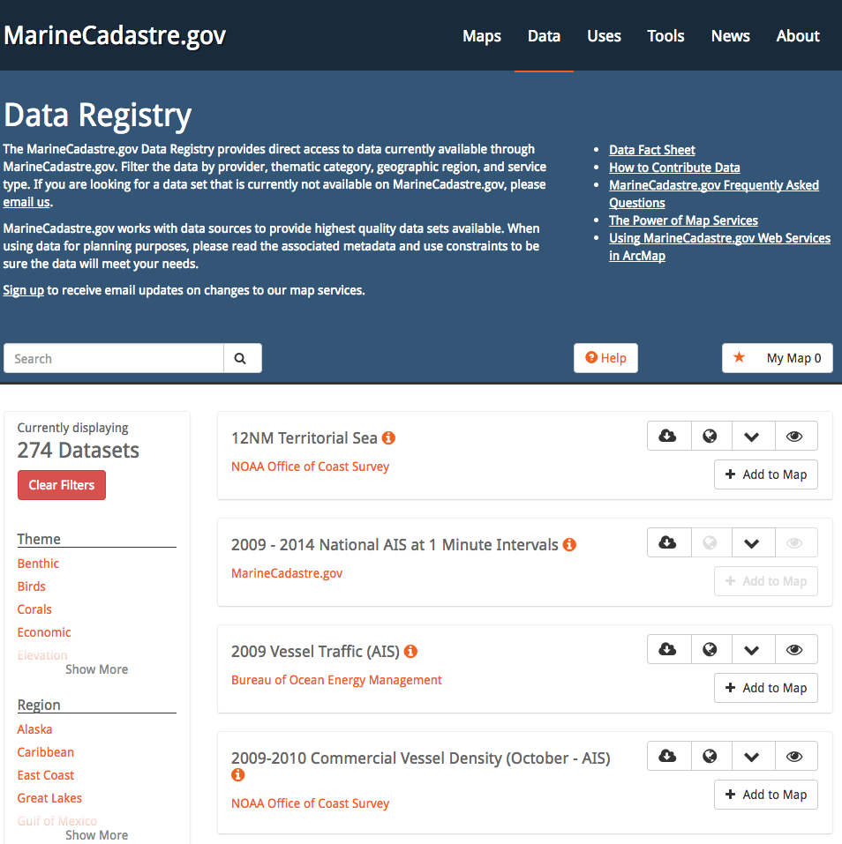
Many data layers, how to synthesize?
Notes:
How to meaningfully combine these many data layers?
What other data is needed?

Slide 7
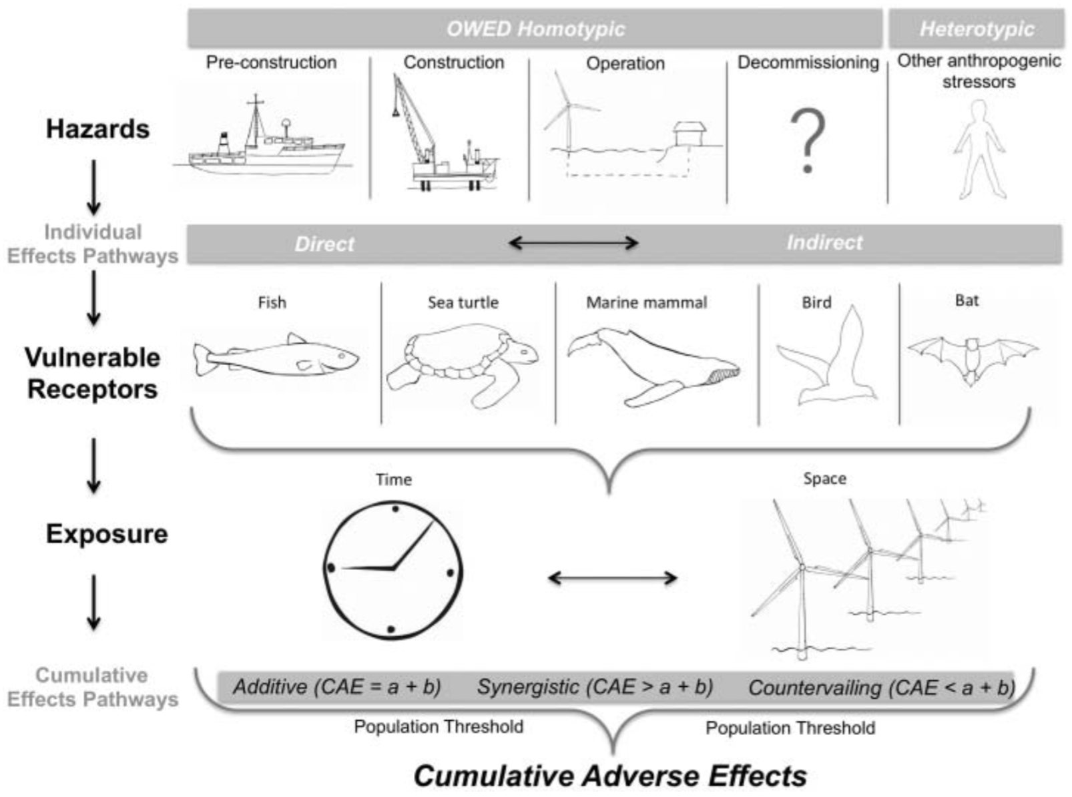
Environmental interactions are complex
Goodale & Milman (2016)

Slide 8
Past Approaches

Slide 9
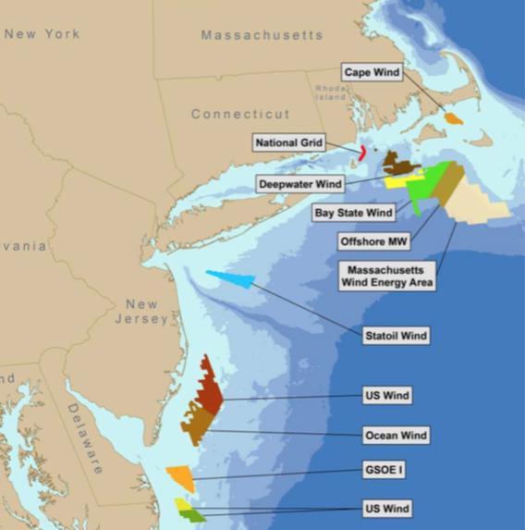
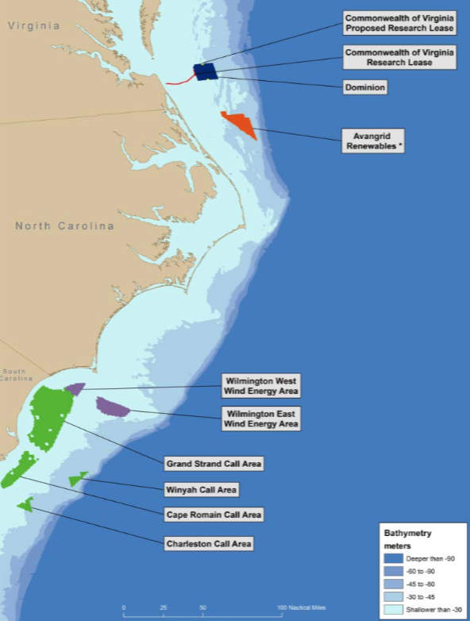
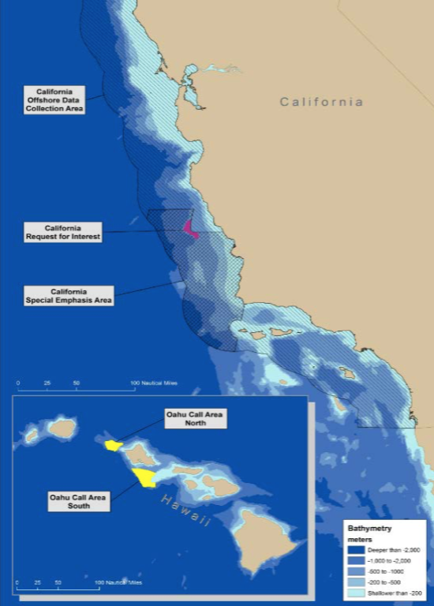
Wind Energy Areas: stakeholder process (BOEM)
Musial et al. (2017) 2016 Offshore Wind Technologies Market Report. NREL
Notes:
Figure 1.14. Current federal offshore wind leases, Wind Energy Areas (WEAs) and call areas in the Atlantic Offshore Continental Shelf. Source: (Smith et al. (2015) , illustration by Josh Bauer, NREL
Map is old. In 2017 report. BOEM gave new. Now being leased, and go through full marine spatial planning process that’s becoming mature in East coast and think about how to do this on West coast.
BOEM: Joan not, but prob Doug.

Slide 10
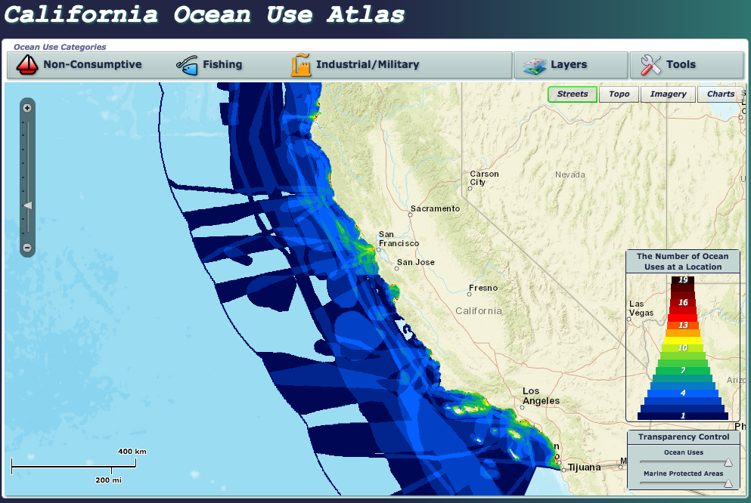
Ocean uses
: unweighted
marineprotectedareas.noaa.gov/dataanalysis/ocean_uses
Notes:
Overlaying the right layers?
Right weights?
And how to flag conflicts with alternatives
Equal weights = naive approach

Slide 11
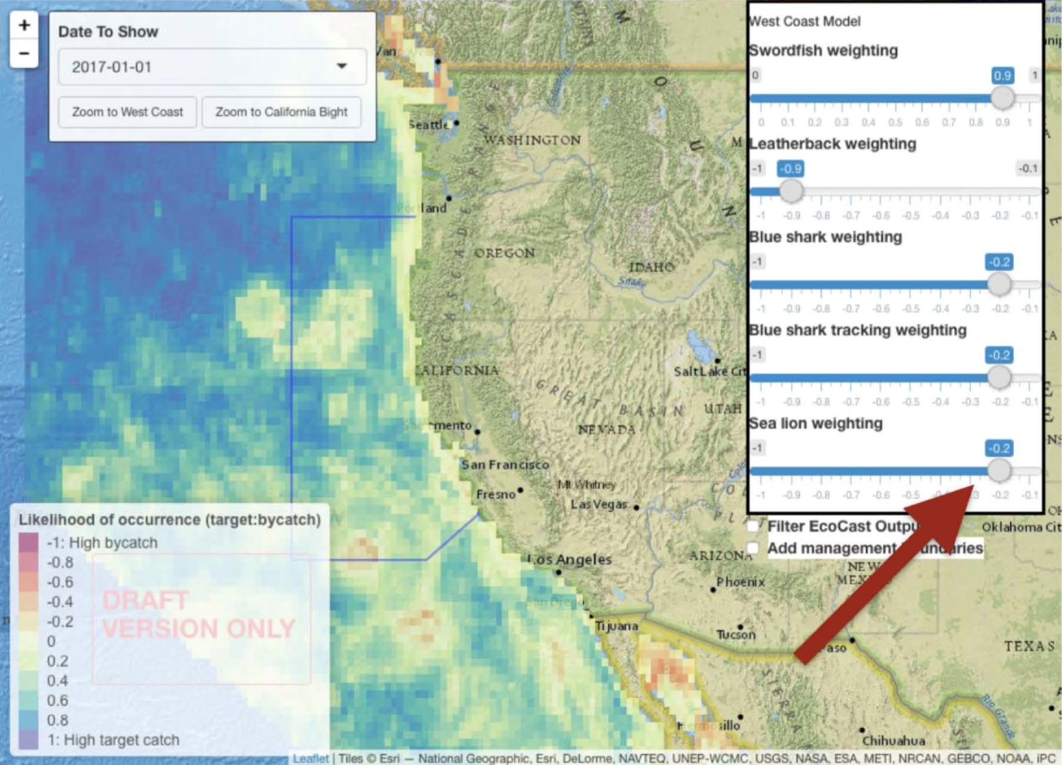
User defined weights
Hazen et al (2017) EcoCast. Presentation to NOAA One Science Seminar
Notes:
Use sliders or upload table with weights. This is using R Shiny.

Slide 12
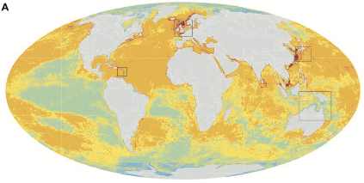
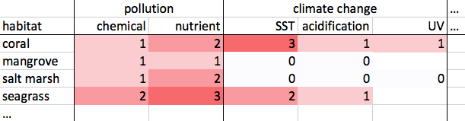
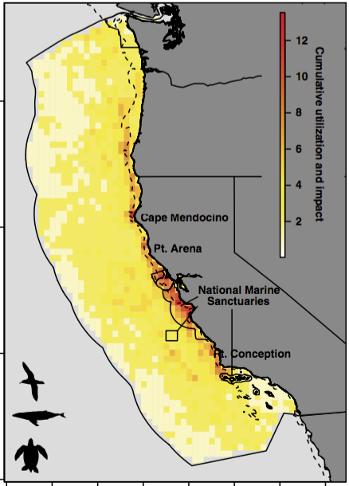
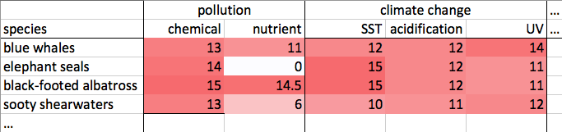
Expert derived weights
Cumulative impact analysis habitat x human impact Halpern et al (2008) A Global Map of Human Impact on Marine Ecosystems. Science
species x human impact Maxwell et al (2013) Cumulative human impacts on marine predators. Nature Comm.
Notes:
Rescale each layer [0-1], then multiply weights and add
And how this relates to competing ocean uses:
Species synthesis: take many species distribution layers and combine into overall sensitivity so columns are renewable energy (not human impact)
Ocean use conflict: evaluate ocean

Slide 13
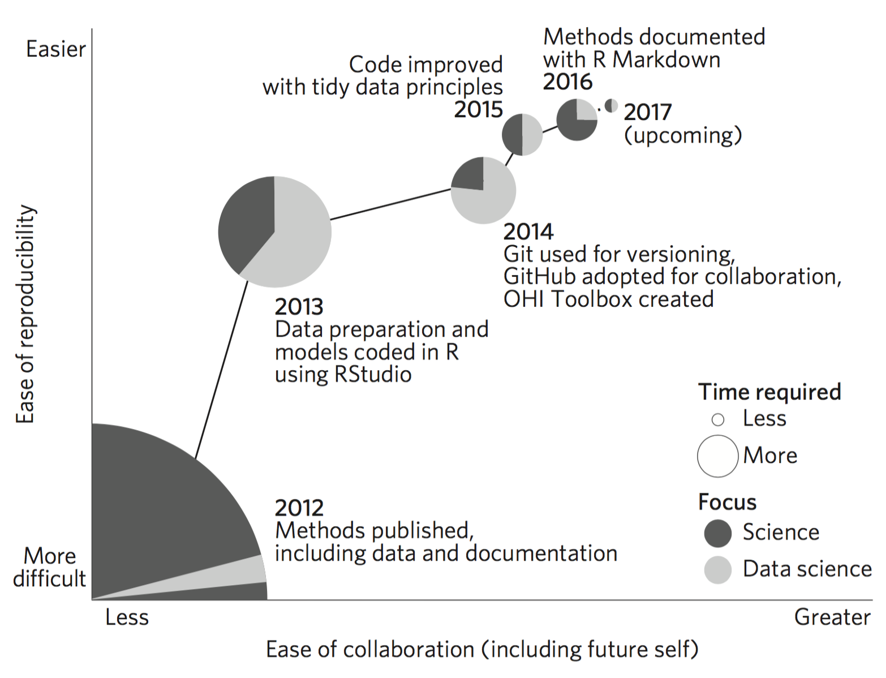
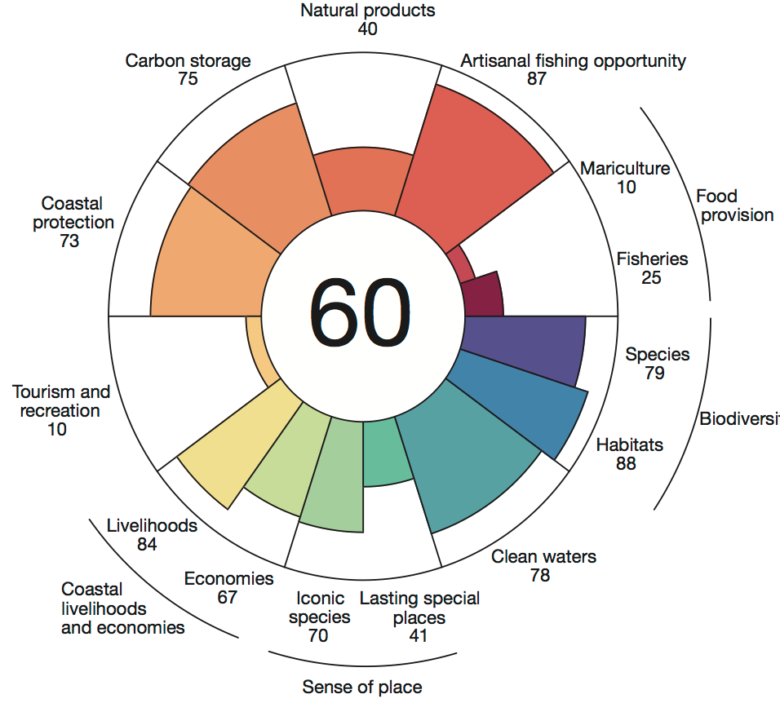
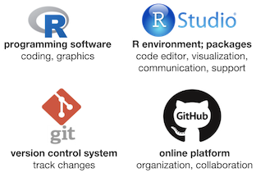
Open data science tools - Ocean Health Index
ohi-science.org
Lowndes, Best et al (2017) Our path to better science in less time using open data science tools. Nature Eco & Evo

Slide 14
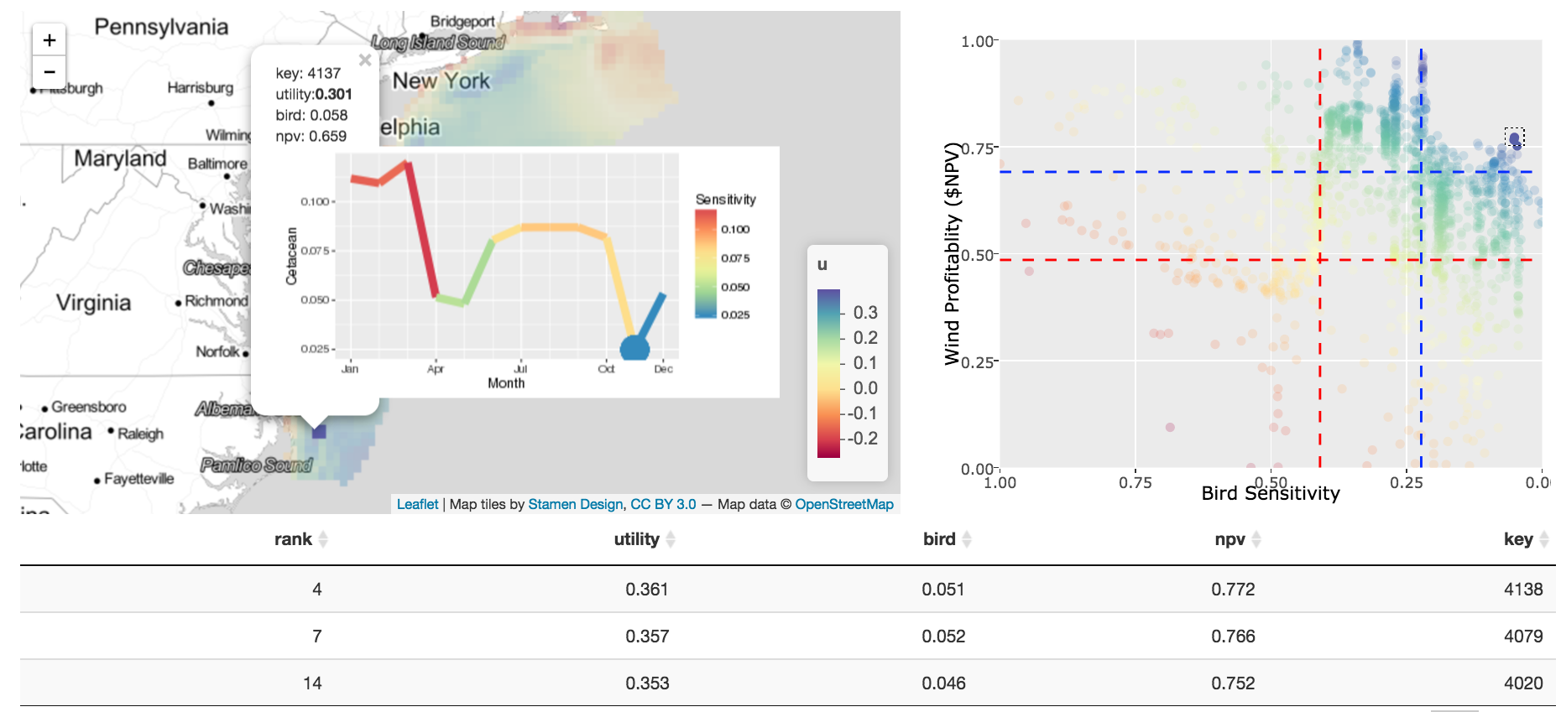
Spatial decision support system
ecoquants.com/app/siting
Best (2016) Data to Decision in a Dynamic Ocean: Robust Species Distribution Models and Spatial Decision Frameworks. Duke Dissertation
Notes:
Decision support vs decision making system
Evaluate tradeoffs between competing ocean uses in variable space (ea on own axes) and as a map, or even a timeseries (months of year).

Slide 15
Present Cable Analysis

Slide 16
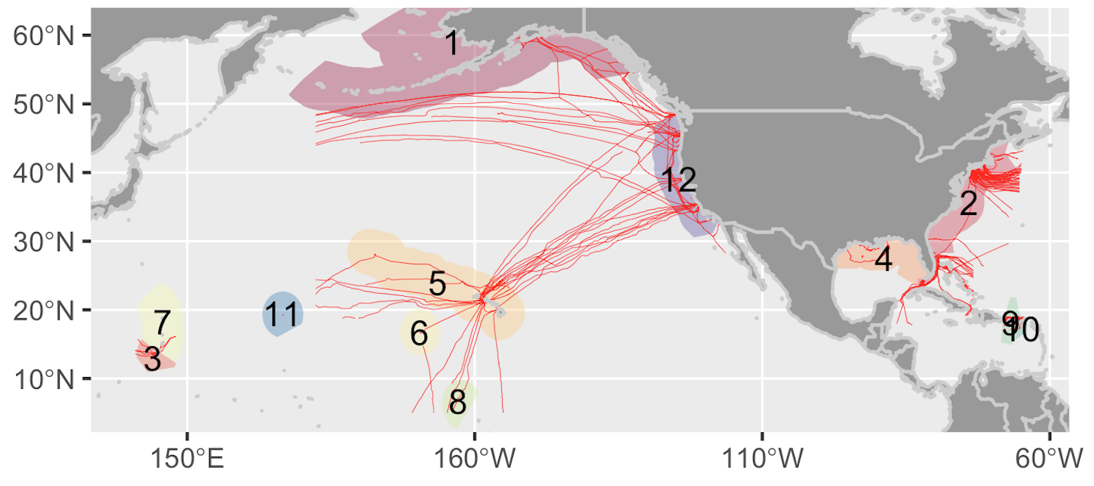
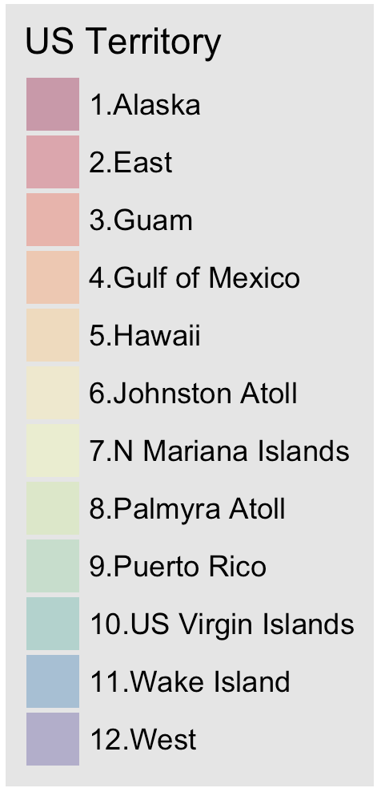
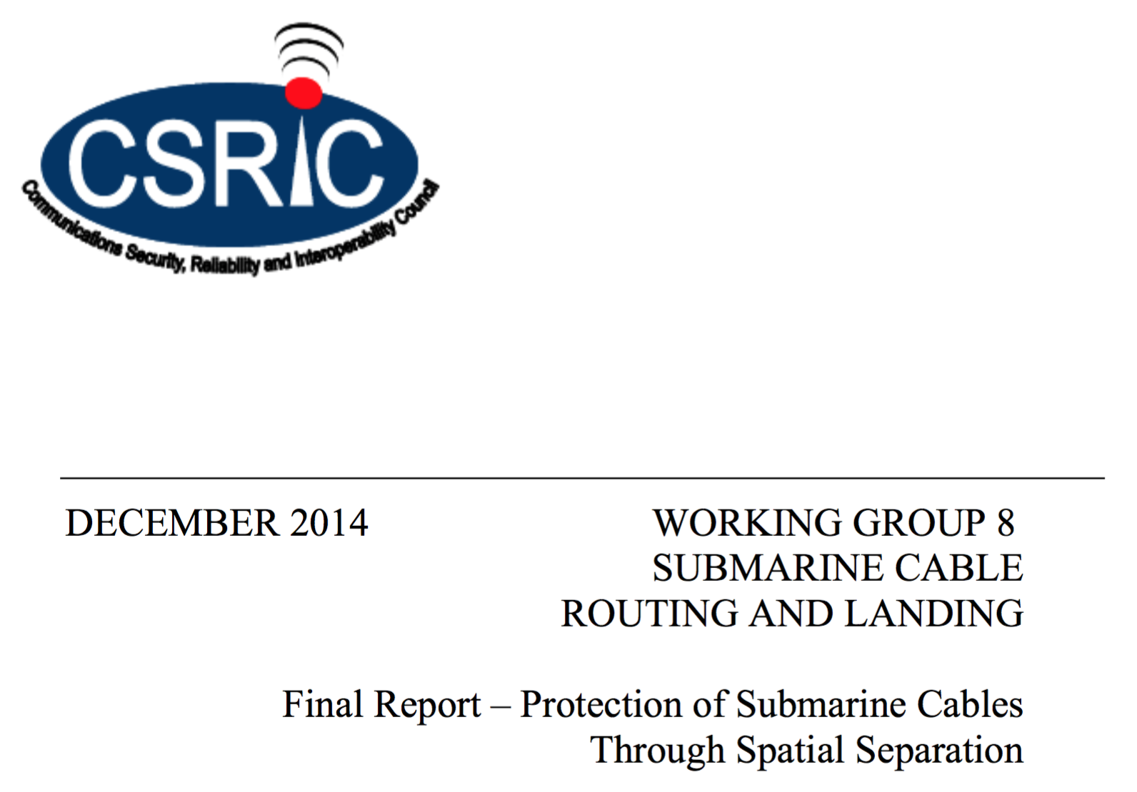
Submarine cable safety product
Derive from Submarine Cables (on MarineCadastre.gov)
Territory | Tide | Wave | Wind
Alaska | ✔ | ✔
East | ✔ | ✔ | ✔
Gulf of Mexico | ✔ | ✔ | ✔
Hawaii |  | ✔ | ✔
Puerto Rico | ✔ | ✔
US Virgin Isl. | ✔ | ✔
West | ✔ | ✔ | ✔
Apply industry advised horizontal buffers based on depth
Minimum: max(500m, 2 x depth)
Recommended: max(500m, 3 x depth)
Extract overlap with energy resources: tidal, wave, wind (tidal: Haas et al 2011; wave: P. T. Jacobson et al 2011; wind: Schwartz et al 2010)
Notes:
Industry organizations—including the International Cable Protection Committee (“ICPC”) and the North American Submarine Cable Association (“NASCA”) have developed and/or endorsed recommendations

Slide 17
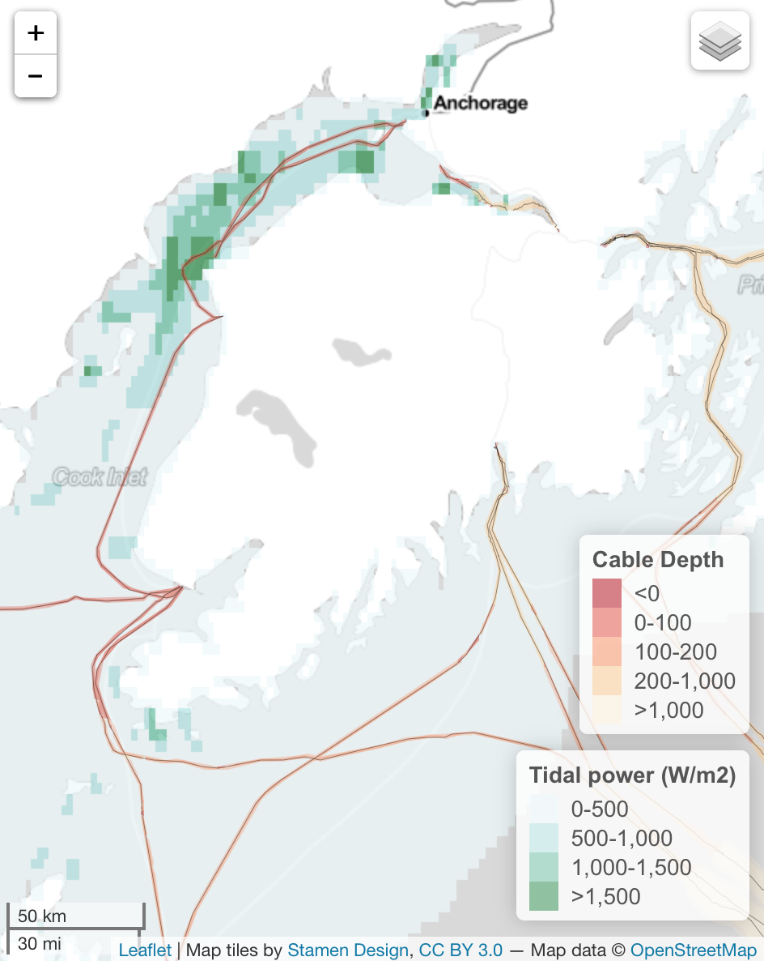
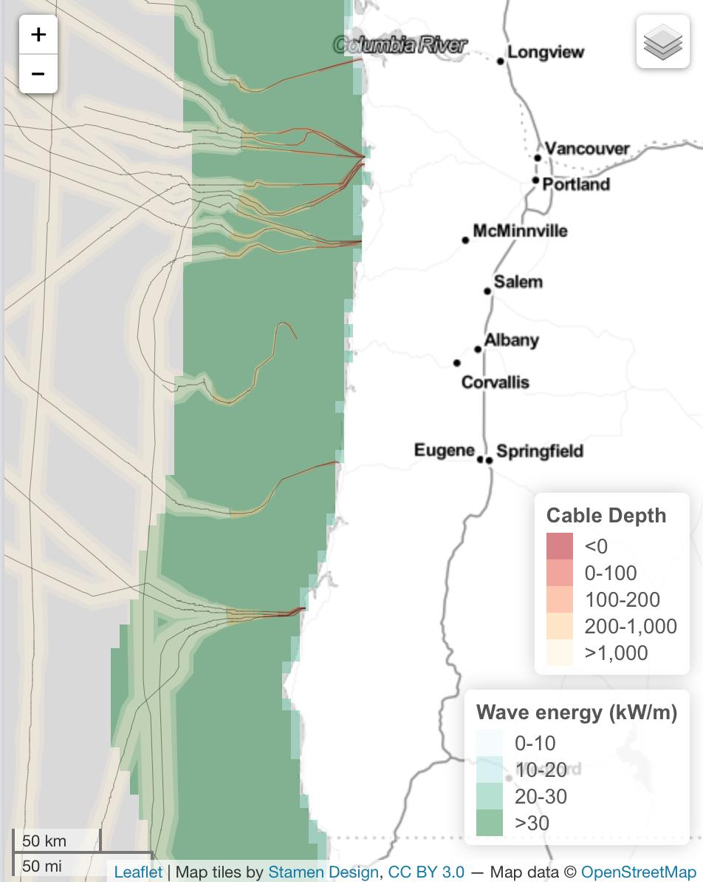
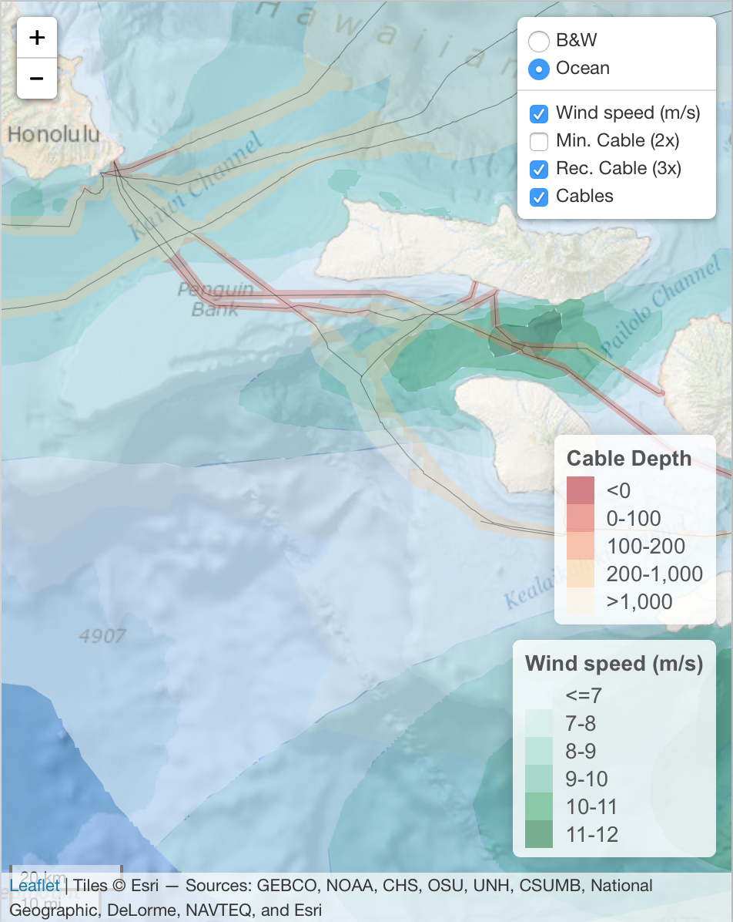
Depth-varying cable buffer
Tide in Alaska
Wave in West
Wind in Hawaii
ecoquants.com/nrel-cables
Notes:
Derived new data layer from existing, risk to industry, energy resource,
Table of regions w/ energy use; plots of use with depth

Slide 18
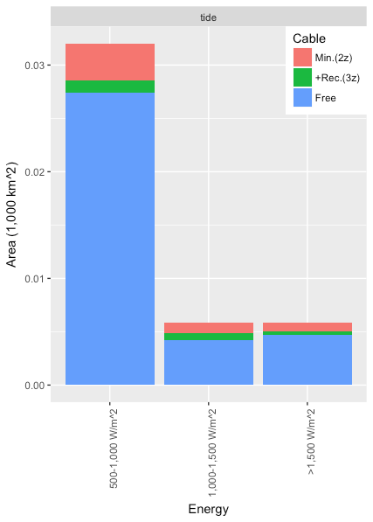
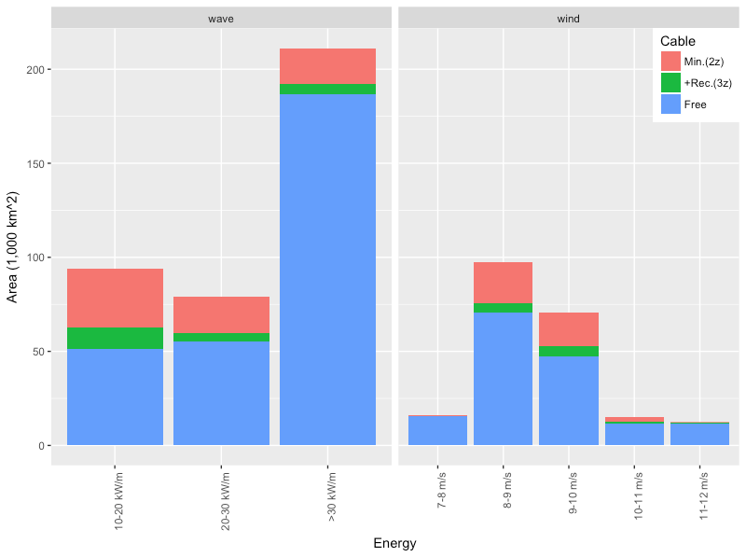
Overlap of cable buffers with energy resources
Tidal (<=100m depth)
Wave (<=200m depth)
Wind (<=1,000m depth)

Slide 19
Future Competing Uses Analysis

Slide 20
Future NREL Competing Use Work
Timeline: Oct 2017 - Oct 2018
Goal
Provide common reference to competing uses and potential conflict when evaluating marine renewable energy
Update Black & Veatch (2010) report with open, current data
Utilize best available data with best available science to provide decision support (advisory vs. exclusive)
Create tool to ingest data layers and evaluate competing ocean uses
Data sources
MarineCadastre.gov (scrape-marinecadastre)
Others: CA Offshore Wind Energy, West Coast Ocean Data Portal, Northeast Ocean Data Portal, Mid-Atlantic Ocean Data Portal, Governors' South Atlantic Alliance Portal, Gulf of Mexico Data Atlas
Notes:
Not just a report
But also an interactive tool

Slide 21
Ocean use categories
Nonliving Resources
Energy Resources (n=8) Oil Resources, Natural Gas Resources, Tides, Wind, Ocean Currents, Geothermal Resources, Ocean Thermal Resources, Solar Radiation
Material Resources (n=2) Sand Resources, Mineral Resources
Physical/Chemical Features (n=5) Physical Habitats and Geomorphology, Bathymetry and Elevation, Substrate, Water Column Features, Water-Quality Parameters
Living Resources
Habitat
Ecological Functions and Services (n=2) Biological Production, Biodiversity
Biological Occurrence (n=7) Fishes, Invertebrates, Flora, Mammals, Birds, Reptiles, Invasive Species
Governance
Marine Protected Areas (MPAs)
De Facto MPAs
Commercial Leases
Jurisdictional Boundaries
Tribally Governed Areas
Regulatory Use Restrictions
Ocean Uses
Recreational Nonextractive / Cultural Use (n=10) Scuba/Snorkeling, Swimming, Surface Board Sports, Paddling, Sailing, Motorized Boating, Wildlife Viewing at Sea, Tide Pooling, Shore Use, Cultural Use
Harvesting Living Resources (n=9) Pelagic Fishing, Fishing with Benthic Mobile Gear, Fishing with Benthic Fixed Gear, Kayak Fishing, Dive Fishing, Fishing from Shore, Gathering from Shore, Offshore Seaweed Harvest, Hunting
Energy Production (n=6) Wind Energy Production, Wave Energy Production, Ocean Current Energy Production, Tidal Current Energy Production, Ocean Thermal Energy Conversion, Offshore Oil and Gas Production
Transportation (n=3) Shipping, Cruise Ships, Military Vessels
Other Commercial/Industrial Uses (n=7) Mining and Mineral Extraction, Offshore Aquaculture, Coastal Aquaculture, Seawater Intake, Sewage Discharge, Ocean Dumping, Underwater Transmission Cables
Infrastructure
Ports
Cables, Pipelines, and Power Grids
Buoys and Navigational Aids
Structures
Lightsom et al (2015) Data categories for marine planning. USGS Report

Slide 22
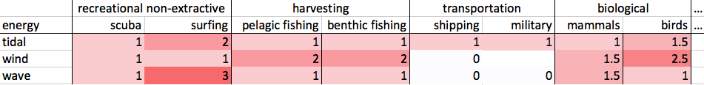
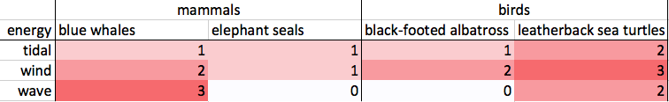
Ocean Use Weighting
energy x ocean use
energy x ocean use - species
average
Notes:
Literature search
Hierarchical
Data gaps inevitable
Uncertainty tricky

Slide 23
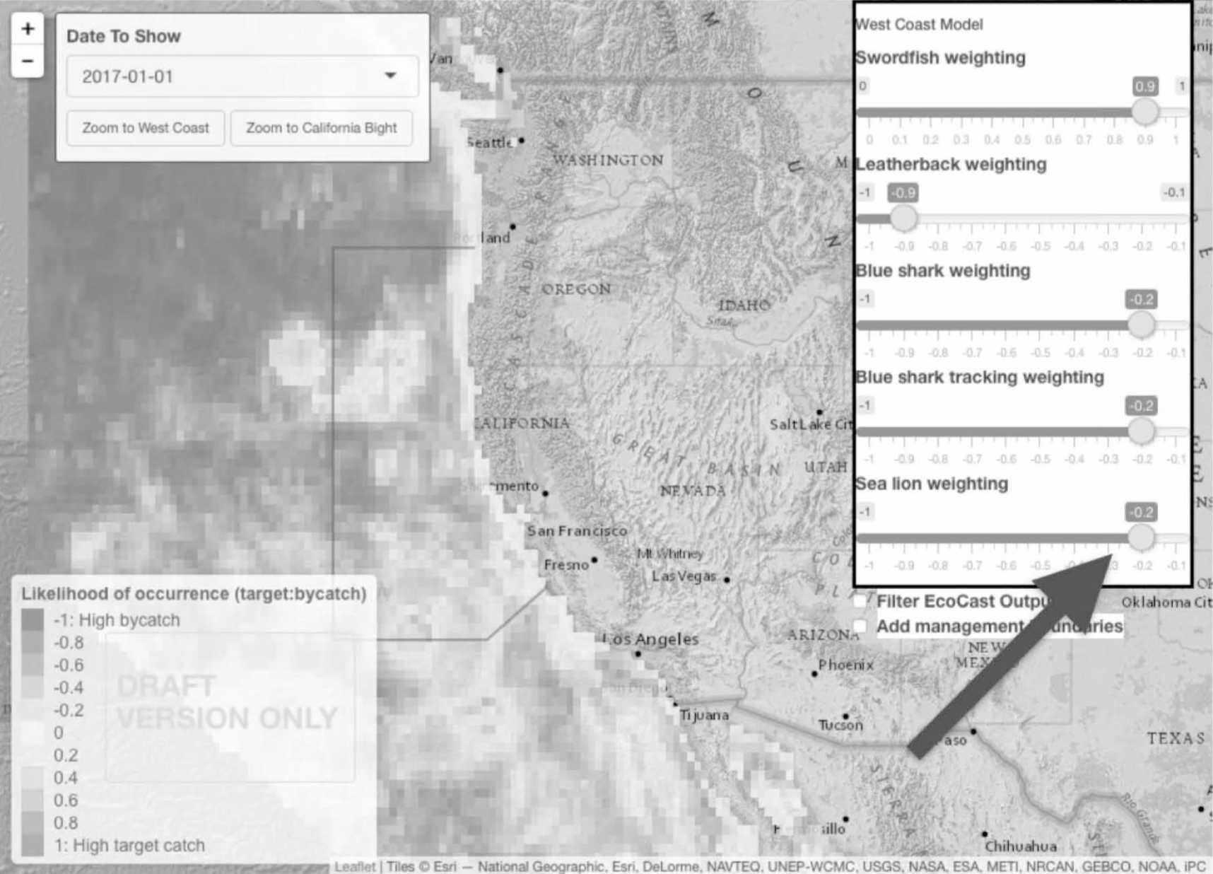
Tool for competing ocean uses
Functions
Fetch data layers from data catalogs
Integrate rescale layers, apply weights, aggregate
Visualize maps, plots, tables; static/interactive
Weights
Default even weighting
Upload table
Modify with sliders
Output
Report
Bookmark URL
Graphical User Interface (GUI)

Slide 24



Future Work
Detailed Parameters & Models
Qualitative Index → Quantitative Units
General Implementation → Specific Configurations
Application Sandwich
Portal: Catalog
Curate catalog of data layers
Make available online via web services
App: Competing Uses
Integrate layers for siting, permit prep
Enter weights and other parameters
Run models
Output results as static reports, interactive app
Portal: Community
Spatially comment
Internally vet proposals
Externally engage stakeholders
Portal: Catalog
consume
App: Uses
publish
Portal: Community
Notes:
Detailed Parameters
Beyond index approach, to get at population level impacts, eg estimate Potential Biological Removal (PBR) for MMPA
Example: For wind farm, enter location and configuration (turbine height and rotor diameter), which evaluates local bird sensitivities (based on species average flight altitude, per Garthe & Huppop (2004) bird sensitivity framework)
Near term: give you maps
Future: summaries of what maps mean. Auto-generated report specific to conditions proposed.
Send link to ppt.

Slide 25
Thank you
comments / questions most welcome
ben@ecoquants.com

